Slide 1
Course : ENTR6003 – Entrepreneurship 1
Year : September 2017
“Customer Profile” (S)
Session 3
F2F

Slide 2
LO 1 : Identify Innovative Business Ideas LO 2: Describe the Value Propositon of the Created Business Idea
Learning Objectives

Slide 3
Sub Topics
Customers’ Jobs, Pains and Gains
Step Into the Customer’s Shoes
The Dos and the Don’ts in Customer Profiling

Slide 4
Customers’ Jobs, Pains and Gains

Slide 5
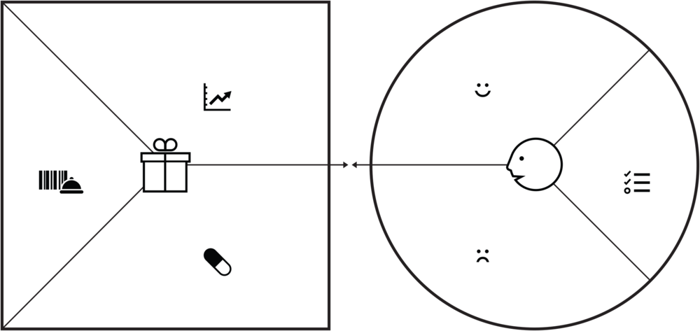
Value Proposition Canvas
It contains of two parts; the Value Map – the square on the left side, and the Customer Profile map – the circle on the right side. We are going to discuss about the customer profile map further.

Slide 6
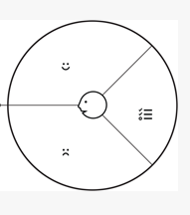
Jobs, Pains and Gains
Customers’ Jobs
Describe what customers are trying to get done in their work or their lives.
Customers’ Pains
Describe bad outcomes, risks and obstacles, related to the jobs.
Customers’ Gain
Describe the outcomes customers want to achieve or the concrete benefits they are seeking.

Slide 7
Customers’ Jobs
Three main types:
Functional Jobs – when your customers try to perform or complete a specific task or solve a specific problem.
Social Jobs – when your customers want to look good or gain power or status. These jobs desribe how customers want to be perceived by others.
Personal/Emotional Jobs – when your customers seek a specific emotional state, such as feeling good or secure.

Slide 8
Customers’ (Suppporting) Jobs
Customers also perform supporting jobs in the context of purchasing and consuming value either as consumers or as professionals. These jobs are different with the three main types.
Buyer of Value – jobs related to buying value such as comparing offeres, deciding which products to buy, standing in a checkout line, completing a purchase, or taking delivery of a product or service.
Cocreator of Value – jobs related to cocreating value with your organization, such as posting product reviews and feedback or even participating in the design of a product or service.
Transferrer of Value – jobs related to the end of a value propositions’ life cycle, such as canceling subscription, disposing of a product, transferring it to others, or reselling it.

Slide 9
Customers’ Pains
Three main types:
Undesired Outcomes, problems and characteristics – pain are functional (such as ‘a solution doesn’t work well’), social (such as ‘i look bad doing this’), emotional (such as ‘i feel bad everytime i do this’), or ancillar (such as ‘it is annoying to go there at this time.”)
Obstacles – There things are the the things that could prevent customers from even getting started with a job or that slow them down (such as ‘ i lack of time to get this job done accurately’).
Risks (Undesired potential income) – what could go wrong and we have important negative consequences such as ‘as i think might lose credibitly when using this type of solustions).

Slide 10
Customers’ Gains
Four main types:
Required Gains – these are gains without which a solution wouldn’t work. Example: the most basic expectation that we have from a smartphone is that we can make call with it.
Expected Gains – These is relatively basic gains that we expect from a solution, even if it could work without them. Example: ever since the Apple launched the Apple, it was changed into the kind of expected phones that people should have – stylish, simple and well designed.
Desired Gains – These are the kinds of gains that go beyond what we has expected from a solution, but the customers would love to get it as long as it could. These are the kinds of gains that the customers would came up when the producers asked them. For example: we wished that the smartphones could be integrated with other devices.
Unexpected Gains –These gains are the kinds of gains that go beyond customers’ expectations and desires. They wouldn’t even come up when they were being asked. For example, the touchscreen technology.

Slide 11
Step Into the Customer’s Shoes

Slide 12
Step into the Shoes
This is a terminology of saying that to understand how others think, we should be able to play as their role.
In term of business, when we are talking about the customer profile (jobs, gains, and pains), it means we should be able to think like our potential customers.
In order to be able to do that, we should create the Customer Profile Map.

Slide 13
How to Step in?
Select the customer segment
Identify the customer jobs
Identify the customer pains
Identify the customers gains
Prioritize job, pains and gains.

Slide 14
The Dos and the Don’ts in Customer Profiling

Slide 15





What Should be Avoided?
Mixing several customer segments into one profilea
Mixing job and outcomes
Focusing on functional jobs only and forgetting social and emotional jobs
Listing jobs, pains, and gains with our value proposition in mind.
Identifying too few jobs, pains and gains
Being too vague in descriptions of pains and gains

Slide 16
What Should be Done?
Make value proposition canvas for every different customer segment
Jobs are the tasks that the customers are trying to perform, solve or to satisfy, whereas the gains are the concrete things that the customers want to achive, or to avoid interm of elimiting the pains.
Sometimes, social or emotional jobs are even more important than the actual gains itself – the functional jobs.
Proceed the process by forgetting what you are actually going to offer.
A Good customer profile should be full of sticky notes, because most customers have lot of pains and expect a lot of gains.
Make the tangible and concrete statement of pains and gains.

Slide 17
References
Alexander O, Yves P, Greg B, and Alan S (2014), Value Proposition Design. John Wiley & Co, New Jersey. ISBN: 978-1-118-96805

